Slide 1


New Brunswick Department of Health, Health Analytics
Virtual Care utilization reports

Slide 2
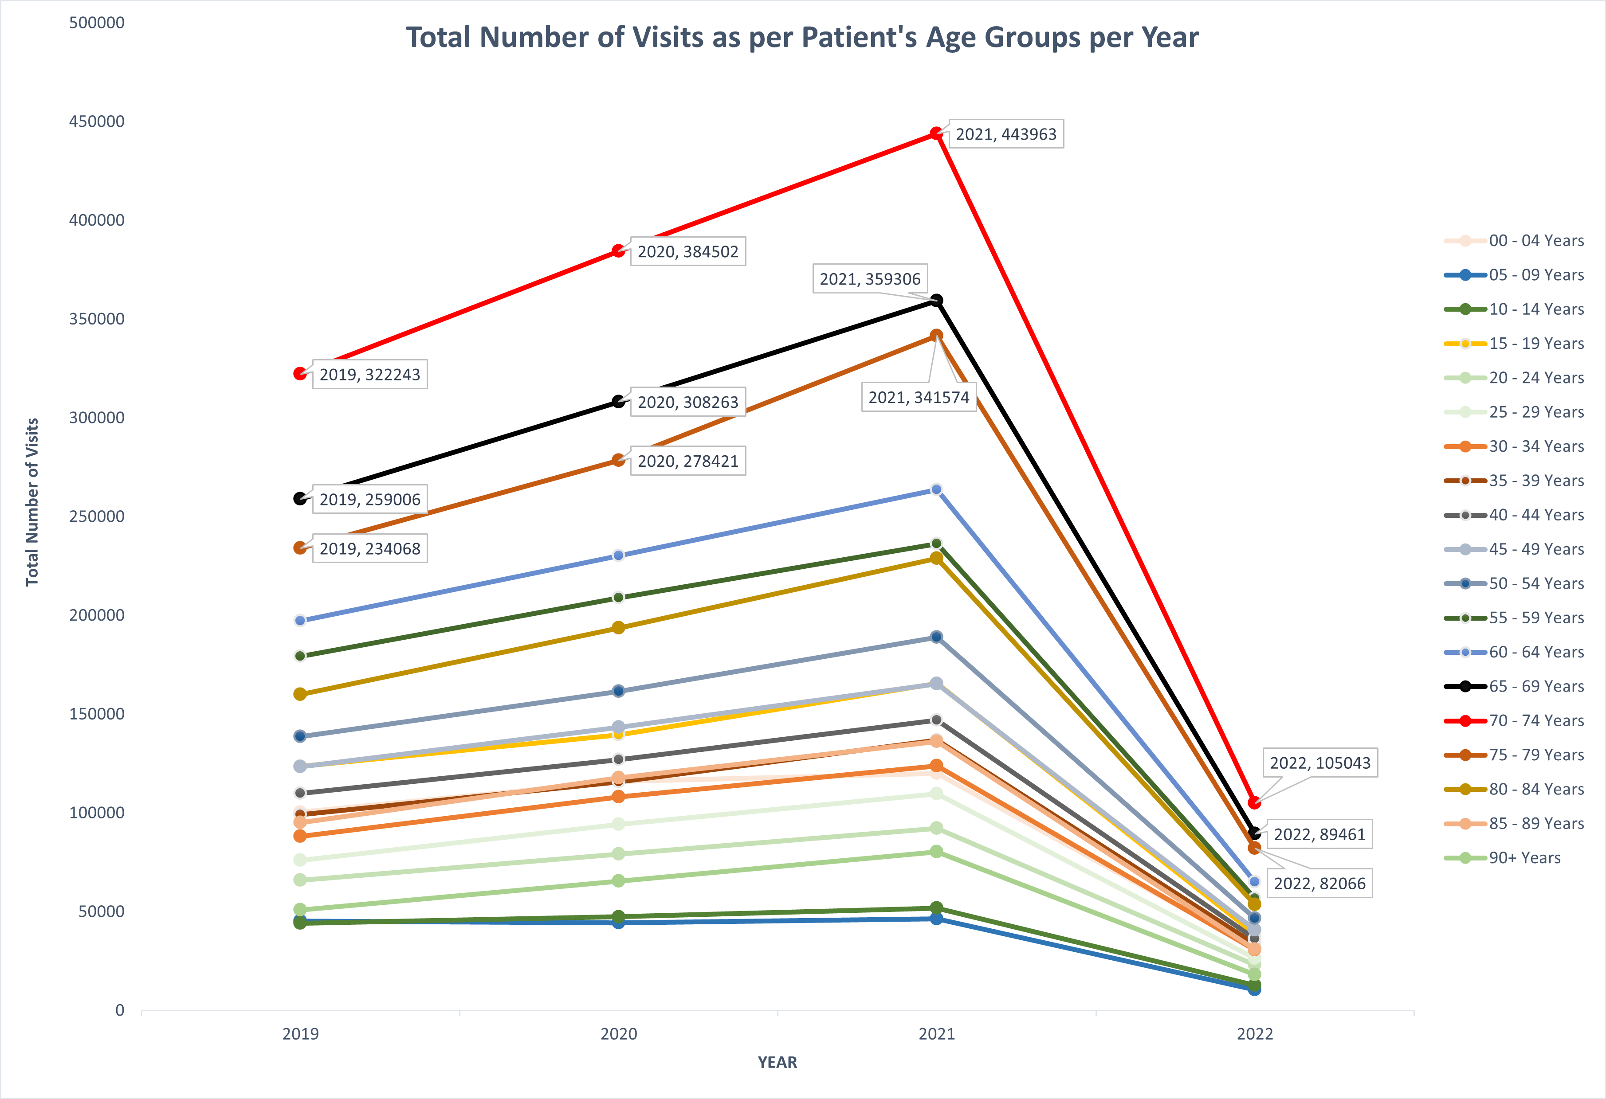
Total Number of Visits of the Patients over the years

Slide 3
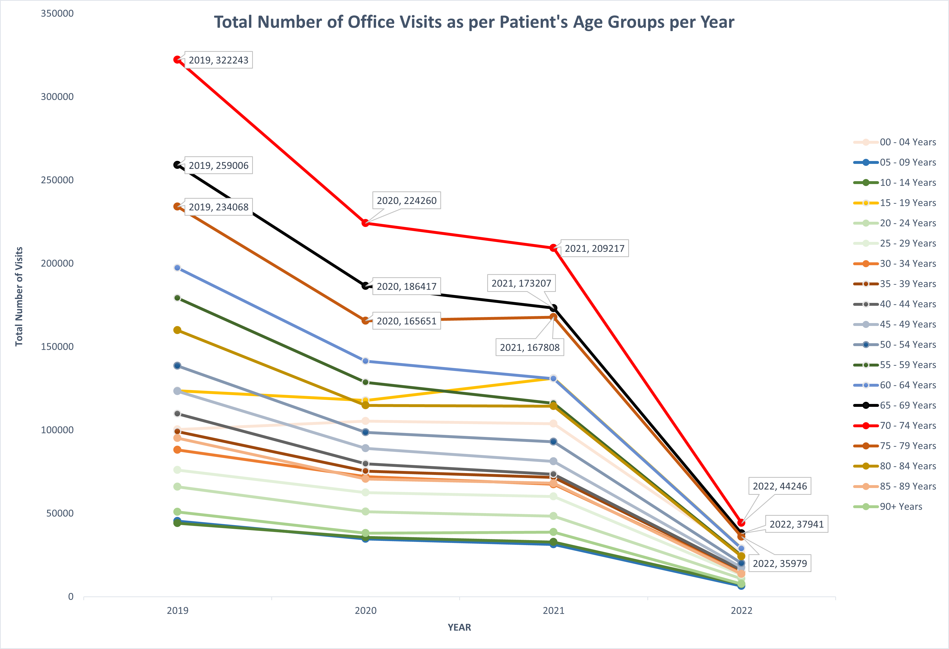
Number of Office Visits of the Patients over the years

Slide 4
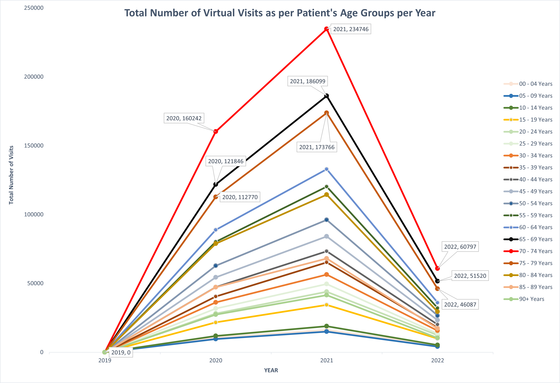
Number of Virtual Care Visits of the Patients over the years

Slide 5
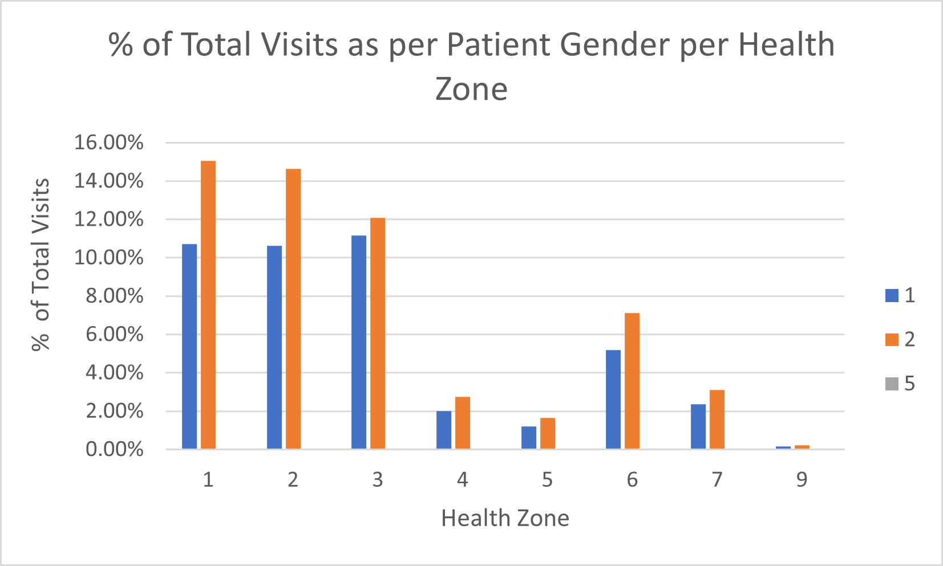
% of Number of Visits of patients as per their genders for different Health Zones
1 – Moncton Area, 2 – Saint John Area, 3 – Fredericton Area, 4 – Edmundston Area, 5 – Campbellton Area, 6 – Bathurst Area, 7 – Miramichi Area
1 – Male
2 – Female

Slide 6
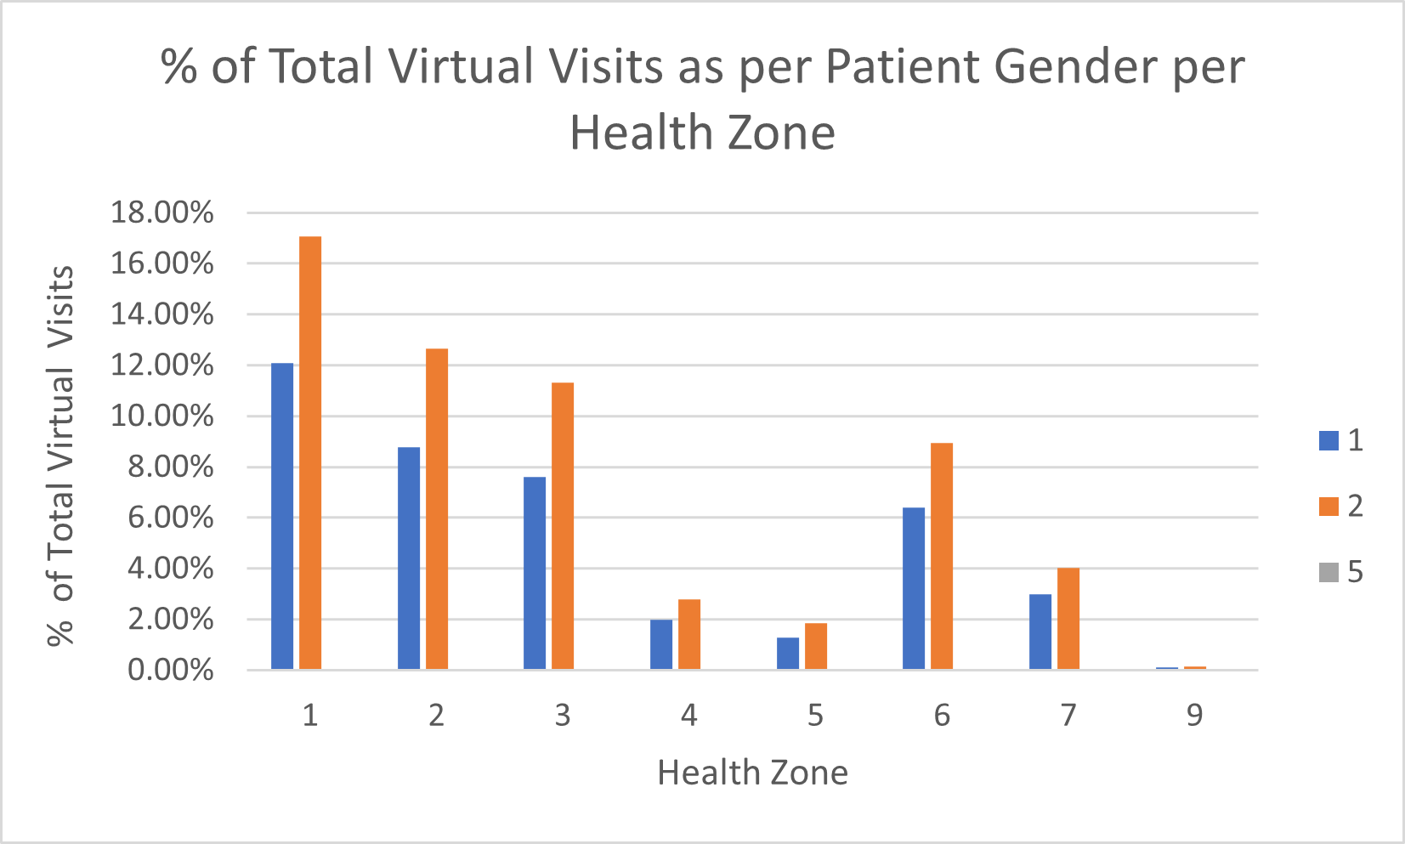
% of Number of Virtual Care Visits of patients different Health Zones
1 – Moncton Area, 2 – Saint John Area, 3 – Fredericton Area, 4 – Edmundston Area, 5 – Campbellton Area, 6 – Bathurst Area, 7 – Miramichi Area
1 – Male
2 – Female

Slide 7
% of Number of Visits of patients as per their Health Zones with respect to the Physician’s Health Zones
1 – Moncton Area, 2 – Saint John Area, 3 – Fredericton Area, 4 – Edmundston Area, 5 – Campbellton Area, 6 – Bathurst Area, 7 – Miramichi Area

Slide 8
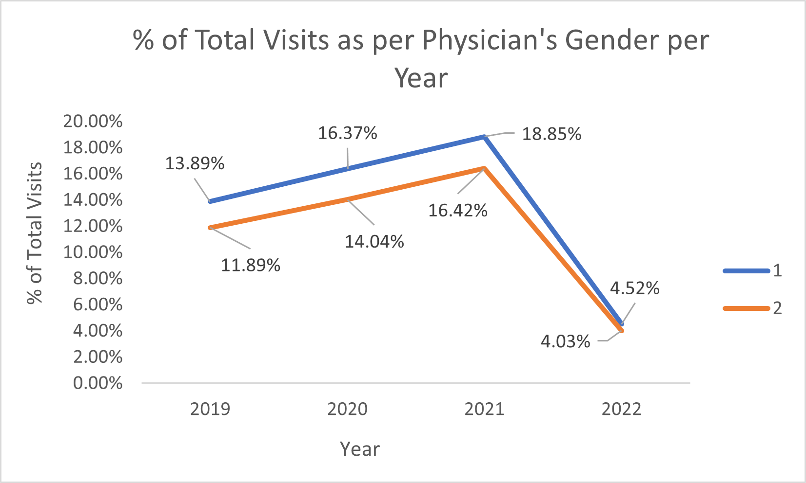
% of Visits performed by physicians of separate genders over the years
1 – Male
2 – Female

Slide 9
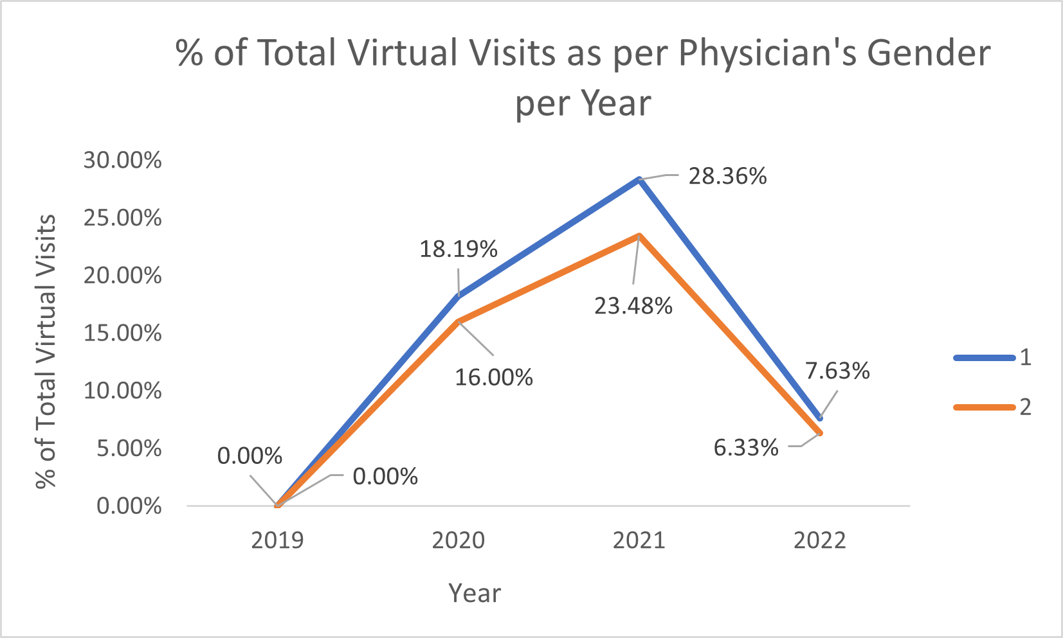
% of Virtual Care Visits performed by physicians of separate genders over the years
1 – Male
2 – Female

Slide 10
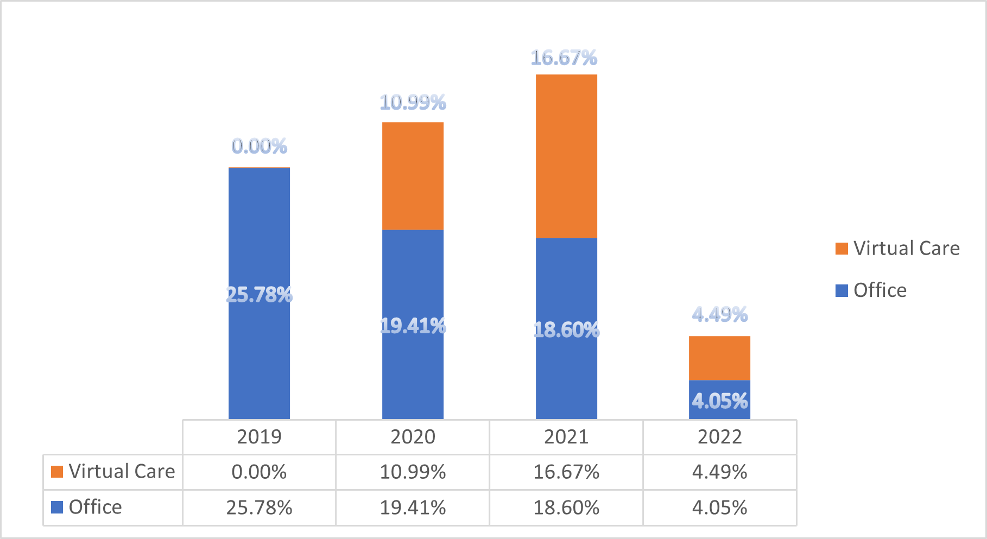
Comparison of % of Total Visits as per their Visit Type over the years

Slide 11
Insights
Top 3 age groups which are higher prone to health risks are: 70-74 age group; 65-69 age group; 75-59 age group.
Female population of all the health zones are more prone to health risks as compared to any other gender.
Number of Female patients are significantly higher than any other gender regarding Virtual Care visits.
Health zones: 1 – Moncton Area, 2 – Saint John Area, 3 – Fredericton Area are top 3 performing in terms of Virtual Care visits.
Conduct surveys in health zones: 4 – Edmundston Area, 5 – Campbellton Area, 7 – Miramichi Area to identify the reasons of low numbers of Virtual Care visits and plan to rectify the issues.
In 2019 Virtual Care visits were almost non-existent, however, as we progressed through the pandemic New Brunswick population have started to switch towards Virtual Care Visits over Office Visits till 2022.

Slide 12

Thank You!
Any questions?

